Slide 1
Group 2
Courtney, Lewis, Tom, and Heather

Slide 2
Game Footage

Slide 3
Feedback
Sounds
Visuals
Aesthetics

Slide 4
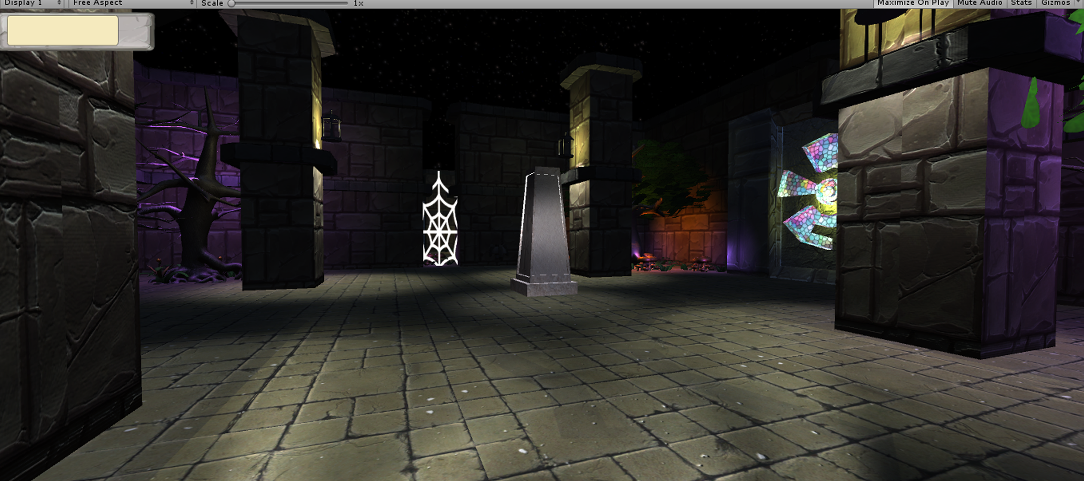
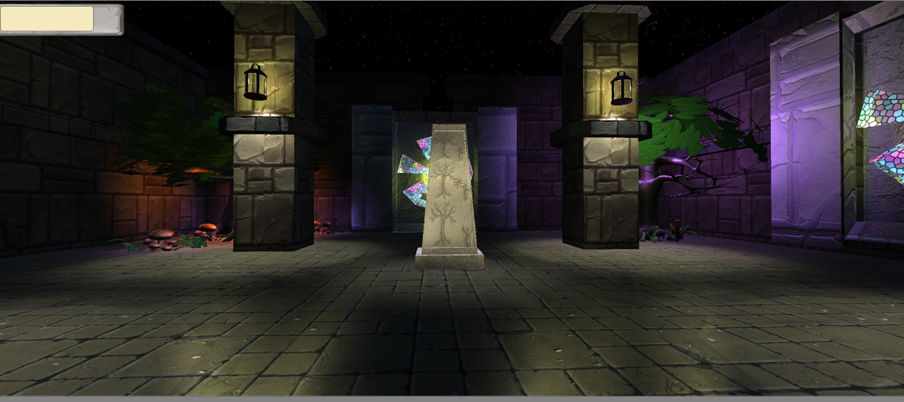
Level 01 Design
Using centre chamber and puzzle rooms as branches.
Japanese Okie principle in design.
-Verticality provided by stairs.
-Architectural Weenies.

Slide 5
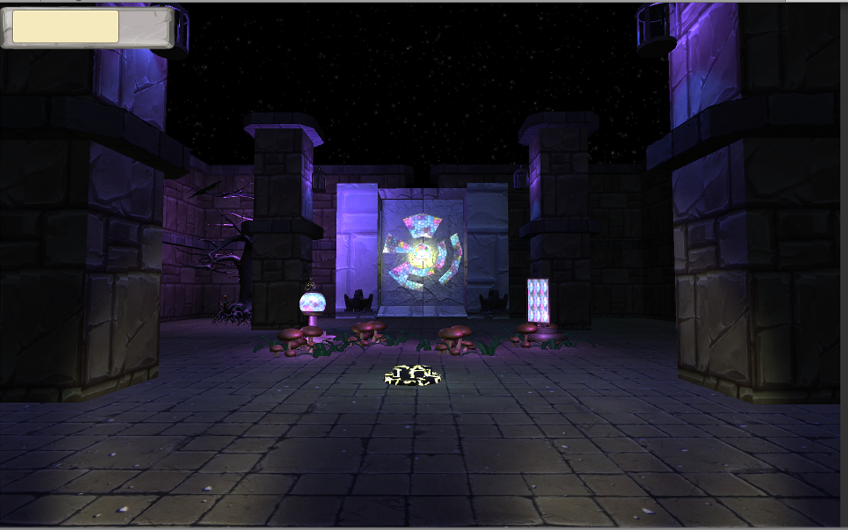
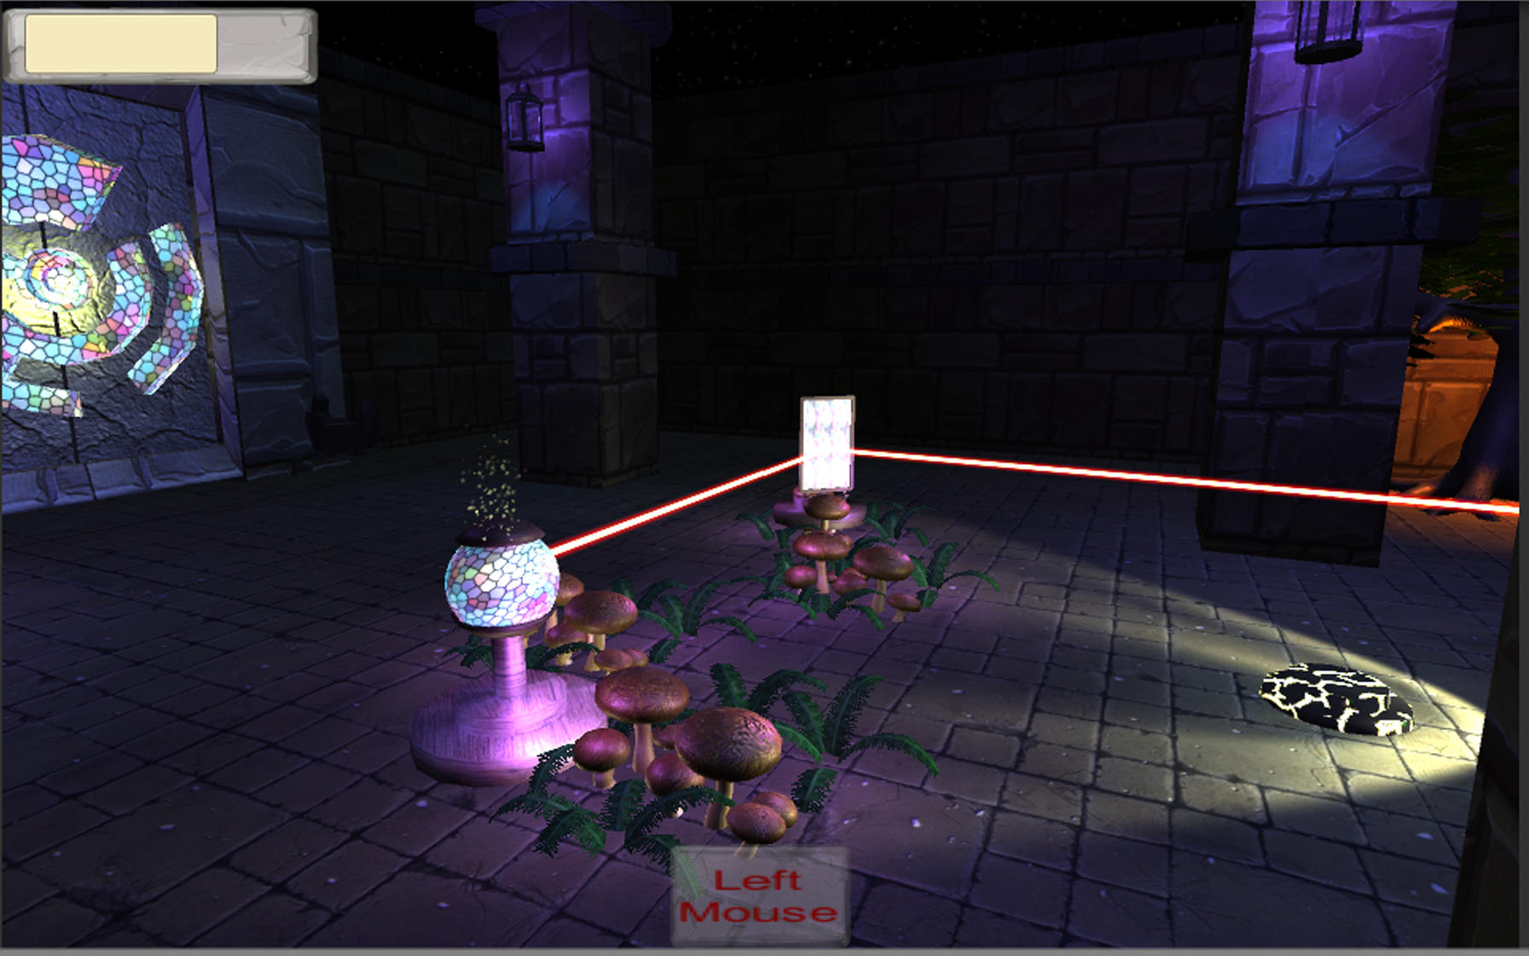
Level 01 Design
Puzzle follows a learn, practise master loop.
Teaching the player:
Rotating mirrors.
Health.
Lighting environment.

Slide 6
Level 01 Design
More fluff about puzzle progression here. ☺

Slide 7
Level 02 Design
Tom :P

Slide 8
Level 03 Design
Courtney :P

Slide 9
Known Issues
Optimisation.
Player Controller (First person vs Third person).
Lighting ☹.

Slide 10
Next Steps
Playtest.
Fix everything revealed by playtesting.
Lighting.
Visual Effects.
Audio Effects.
Menu/End screen art.

Slide 11
Any questions?

